Slide 1

Introduction to Robotics ME 639: Industrial Project Presentation
Project Title: Underwater Manipulator’s Control System
Team Name: Team Pluto
Team Members: Dhvani Shah, Dev Patel, Harsh Shrivastava
Instructor: Prof. Harish PM
Teaching Assistant: Suraj Borate

Slide 2
Problem Statement:
“ Design a control system for a 2 Dof manipulator of an underwater ROV”
Industry name: Planys Technologies
Objectives:
Find the shortest path and duration between two readings
Appropriate value of acceleration and velocity
Account for underwater dynamics in control system
Suggestions of suitable actuators

Slide 3
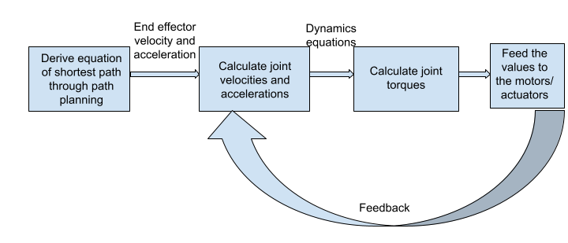
Rationale / Approach / Ideas:
What we had presented earlier

Slide 4
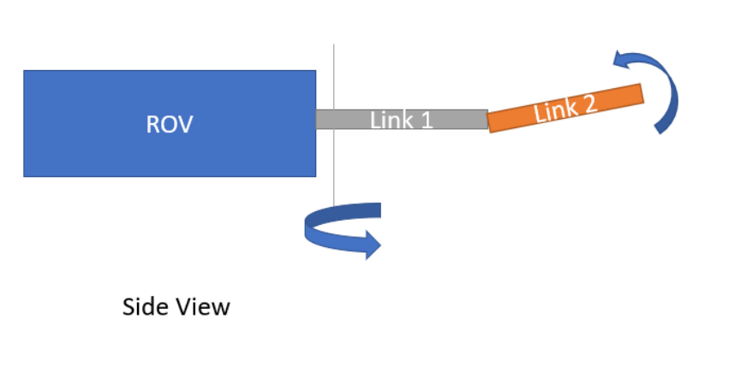
Rationale / Approach / Ideas:
🗹 Deriving the forward and inverse kinematic equation for the manipulator.
🗹 Plotting the workspace
🗹 Looking for the shortest path between two points
🗹 Understanding the underwater dynamics.
🗹 Designing a PD controller for independent joint control.
Dimensions:
m₁ = 1.5 kg, m₂ = 1 kg,
m_{probe} = 0.5 kg
l₁ = 150 mm, l₂ = 300 mm,
l_{probe} = 150 mm (from the given specs)

Slide 5
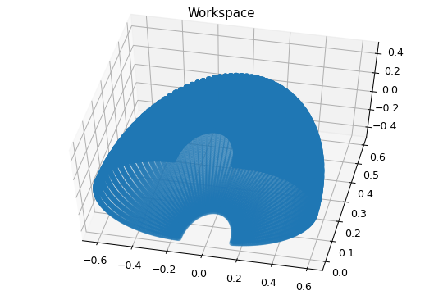
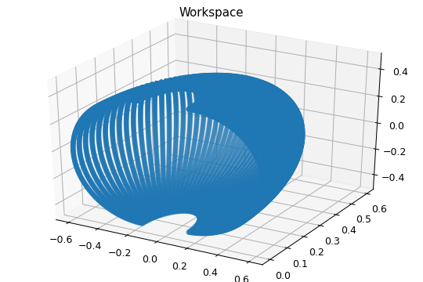
Key Results 1:
Robot Workspace:
Notes:
Angle limits: -90º to +90º
Length:

Slide 6
How workspace is generated...
Workspace is generated using the joint angles - taking a step of 3º for q₁ and 1º for q₂.
The position of end effector is calculated using the dynamic equations and a 3D plot is generated.

Slide 7
Insights / Interim Conclusions / Discussion:
As we can see from the workspace, it is impossible for robot to travel in straight line, as most points won’t lie in workspace.
We propose that instead of deriving the shortest path, we will try to reduce the work done by motor, by allowing minimum angular displacement to reach the desired location.

Slide 8


Key Results 2:
Inverse kinematics:
We have implemented the inverse kinematics code such that given the two coordinate points, we get the angular orientations of both the joints.
Example:
Input:
Output:

Slide 9
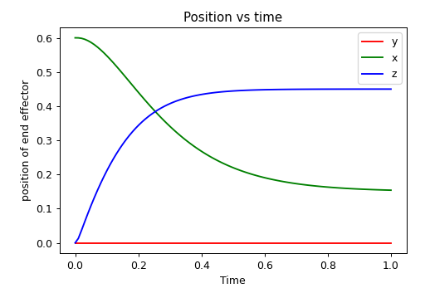
Key Results 3:
Notes:
End effector position w.r.t time
Qualitative Plot
Different set of points are used and shown in key results 5

Slide 10
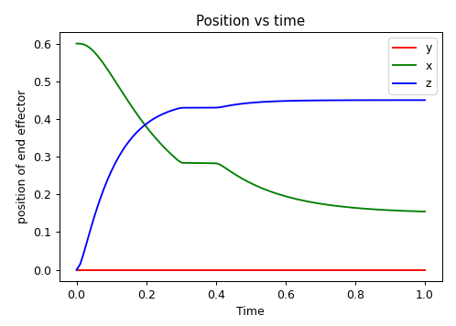
Key Results 3:
Constant disturbance of 100N is applied on link 2
Notes:
End effector position w.r.t time
Qualitative Plot
Different set of points are used and shown in key results 5

Slide 11

Key Results 4:
Example 2:
Input:
Output:

Slide 12
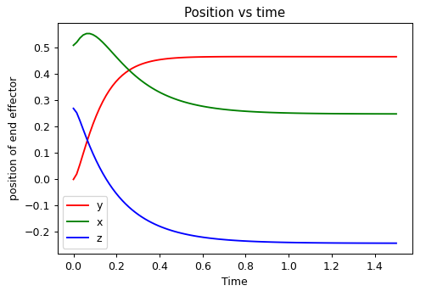
Key Results 5:
Notes:
End effector position w.r.t time
Qualitative Plot

Slide 13
Controls:
We implemented PD Control on the manipulator. Here are the important equations/results/constants/plots.
We have end point joint values as our input for individual joint control.
Constants : Differential Constant(K_{D}) = 100
Linear Constant(K_{P}) = -500
The constants are same for both the independent joint control.
For the given control parameters the end effector reaches from initial position to final position within 1.5s.
Notes:
End effector position w.r.t time
Qualitative Plot

Slide 14




Deriving the equation of dynamics from DH Parameters
Keys steps for deriving dynamics:
Use Euler Lagrange’s equation
Where L= K-V (K= Total Kinetic energy of robot, V= Total Potential energy of Robot)
2) Formulate Matrix D(q); dkj = kth row, jth column element of matrix D(q)
3) Compute Christoffel symbols, Cijk
4) Calculate Torques by,

Slide 15


Equations for dynamics
Assumptions:
Since the change in depth is very less, buoyancy force is neglected
Drag coefficient, C_{D} = 1.2
Links are assumed to be cylindrical in shape, with very small diameter.
Added mass for the links is negligible.

Slide 16
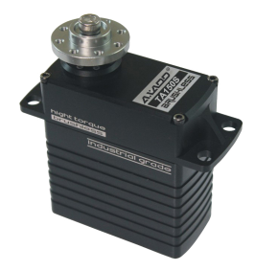
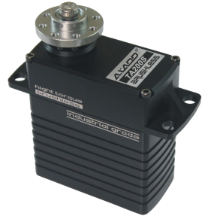
Suggested Actuators
Maximum Torque Calculated: ~14.5 Nm= 147 kg-cm
Following are two Servo motors we found suitable for our purpose:
TA150S Servo Motor, Axadd: 150 kg-cm torque
Link: 150kg-cm torque industrial servo TA150S Degree Rotation Servo Robot-180°Robot Servo
Stall Torque: 15.2N.m(155kg.cm)
2. TA200S Servo Motor, Axadd: 200 kg-cm torque
Link: 200kg-cm torque Ultra Heavy Duty Giant Scale Digital HV Brushless Servo for
RC ROBOT industrial equipment TA200S-180°Robot Servo
Stall Torque: 20.1N.m(205kg.cm)

Slide 17
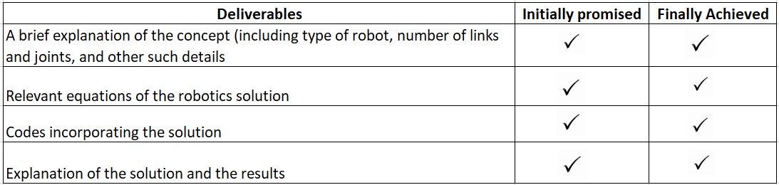
Deliverables - Initially promised v/s achieved
Python Code Link : Code.ipynb - Colaboratory (google.com)

Slide 18
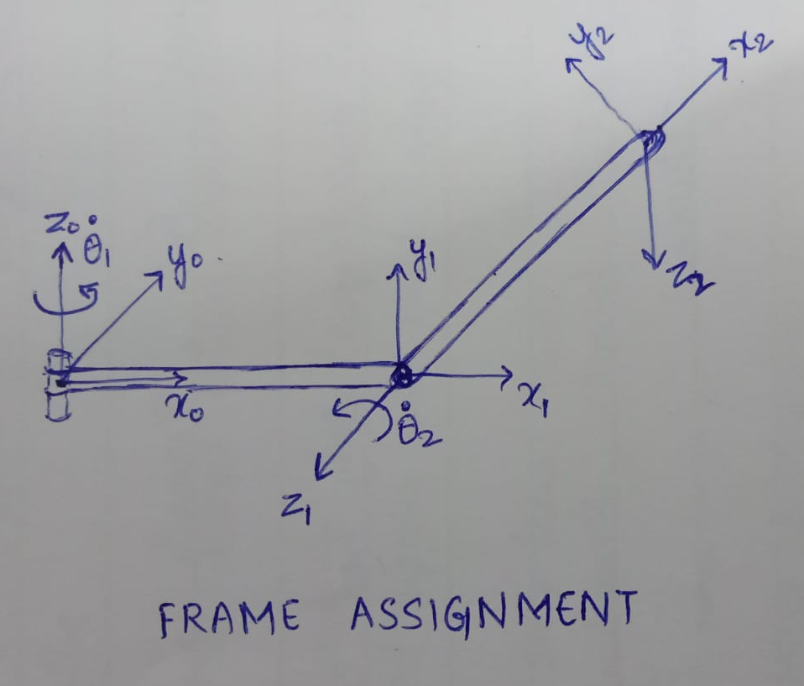
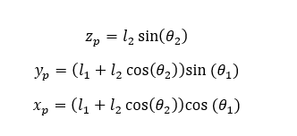
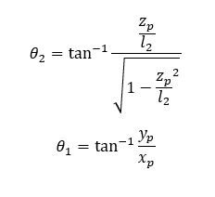
Appendix 1: D-H Parameters and Kinematic Equations
Link | a | d | α | θ
1 | l1 | 0 | 90º | θ₁
2 | l2 | 0 | 0 | θ₂
Forward Kinematic Equations
Inverse Kinematic Equations

Slide 19
Appendix 2: General Dynamic Equation
F is for frictional losses and D is for drag losses.

Slide 20
References
Thor I. Fossen - Guidance and Control of Ocean Vehicles-Wiley (1994)
Investigation into the Dynamics and Control of an Underwater Vehicle-Manipulator System - https://dl.acm.org/doi/pdf/10.1155/2013/839046
Pritchard-Fox-McDonalds_2011_8ed_Fluid-Mechanics

